Slide 1
Using NEDSS for Surveillance
Rules of the road
Utilization of data

Slide 2
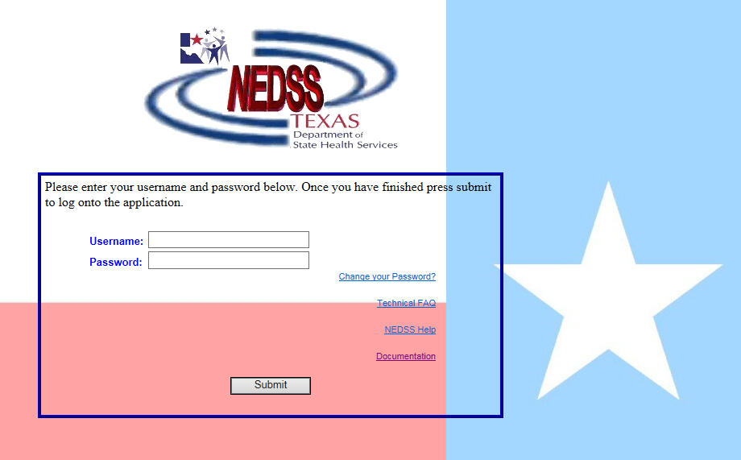
National Electronic Data Surveillance System NEDSS
NEDSS Based System –
NBS
https://txnedss.dshs.state.tx.us:8009/login/login.asp

Slide 3
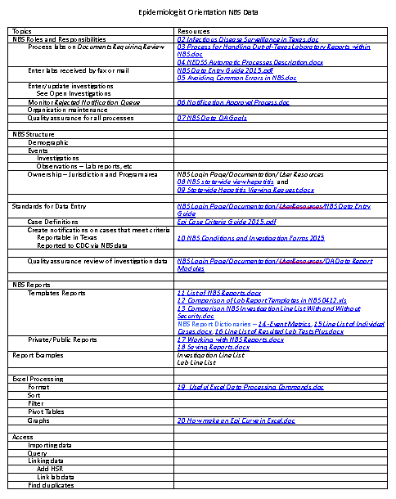
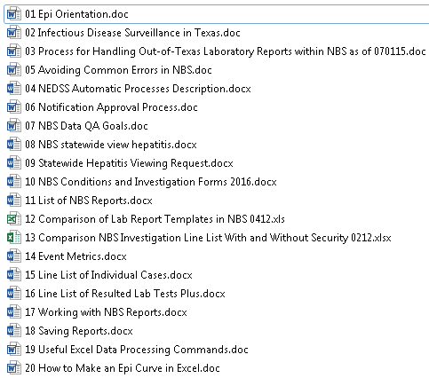
Epidemiologist Orientation - NBS Data (Section 5)

Slide 4
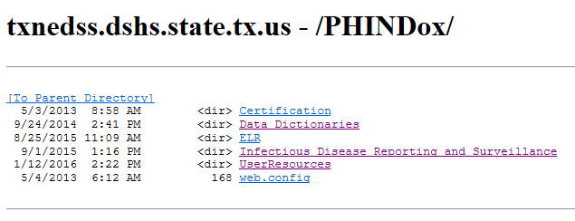
Documentation Link NBS Login Page

Slide 5
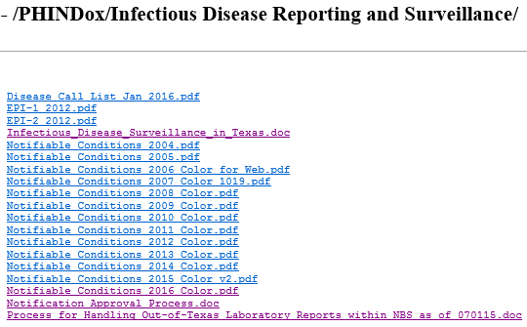
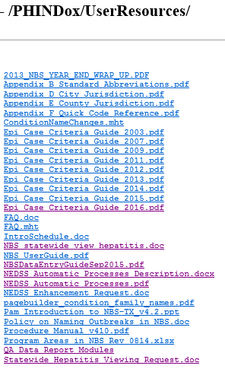
Useful Documents

Slide 6
NEDSS - Shared Data System
Common data
Real-time views
Stored data
Reports
Case review
Standardization
Shared official cases
Roles and responsibilities
Central office
RHD
LHD

Slide 7
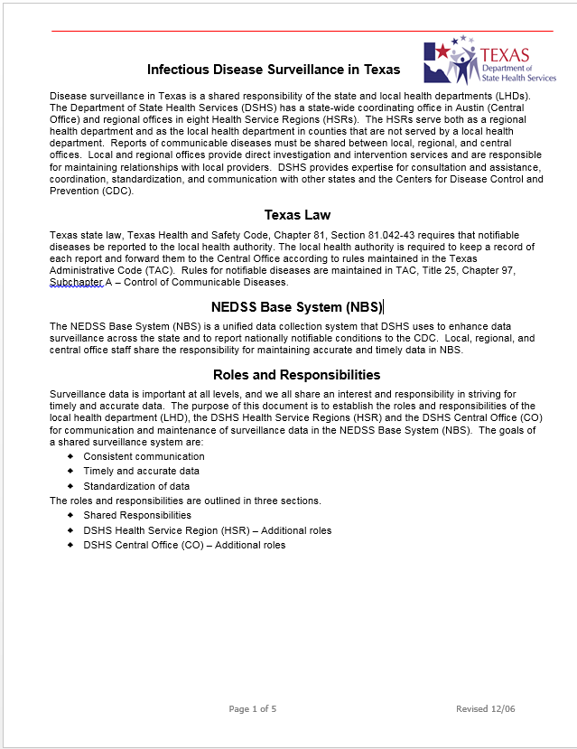
Infectious Disease Surveillance in Texas
Meeting was convened in 2006 to work on processes to utilize NEDSS as a shared data system
Goals, responsibilities, and processes discussed and methods outlined
Document published
See 02 Infectious Disease Surveillance in Texas.doc or copy in txnedss.dshs.state.tx.us - /PHINDox/ Infectious Disease Reporting and Surveillance/
Goals of a shared surveillance system
Consistent communication
Timely and accurate data
Standardization of data
02 Infectious Disease Surveillance in Texas.doc

Slide 8
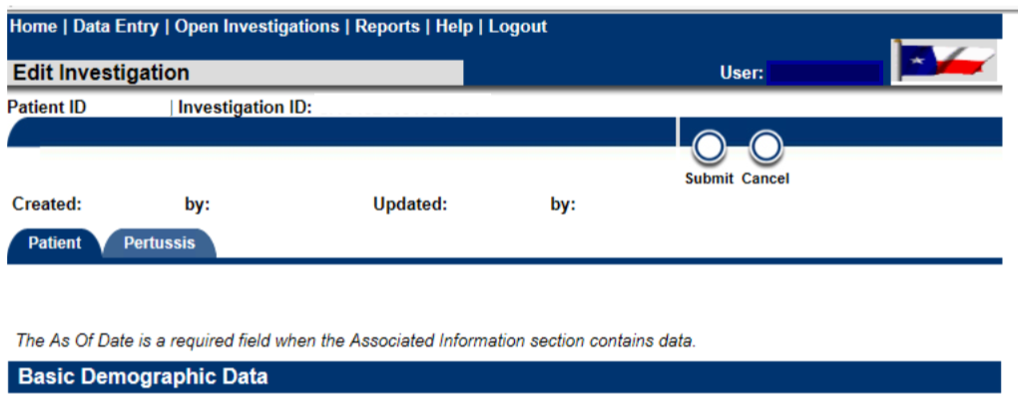
NEDSS Structure
Patient centric
Patient file shows all investigations, lab reports, and other records
Demographics kept with “as-of-date” as information is added
Investigations are the focus of epi interest
Demographics are captured at time of creation
Updates need to be entered in the Patient tab of the investigation
Data entered here will be in investigation report

Slide 9
NEDSS Structure
Ownership Silos – Permission Sets
Jurisdiction
Only see geographic jurisdictions assigned to you
Central Office staff have statewide view
RHDs see RHD and LHDs in their region
LHDs see just their jurisdiction
Applies to queues, events (investigations, lab reports, morbidity reports, vaccination history, etc. and report data
Program Area
RHDS and LHDs see most or all program areas in EAIDB and Zoonosis
TB and animal rabies generally seen by different staff
Central office staff limited by Program Areas relevant to their team
This allows shorter queues and better focus than seeing all conditions statewide
Laboratory reports need to be assigned to correct program area for appropriate CO staff to see it

Slide 10
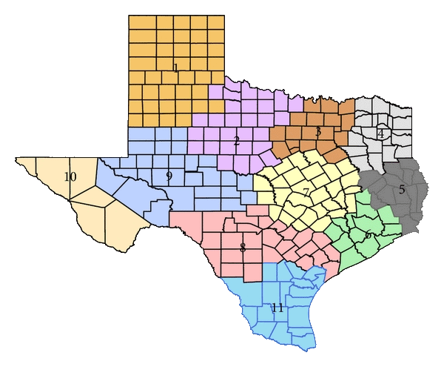
Statewide View See description and request form in Documentation/UserResources
All jurisdictions have statewide view for MDRO program area
CRE
MDR-A
VISA/VRSA
Available on request for hepatitis program areas
Acute hepatitis A,D, E
Hepatitis C
Immunizations
See 08 NBS statewide view hepatitis.docx and 09 Statewide Hepatitis Viewing Request.docx
Pros
See all hepatitis history for patient in NEDSS
Allows more accurate and efficient classification of chronic cases
Sort out jurisdiction when reports are in multiple jurisdictions
Cons
See longer queues
May need to filter for your jurisdiction when working on other conditions
Remember to take action on hepatitis cases only in your jurisdiction

Slide 11
NEDSS – Home Screen
Work the queues
Notice the Notices board
Search for/create patients
Run Saved Reports

Slide 12
NBS Work Queues
Must have notification approval rights to see notification queues
Everyone sees Documents Requiring Security Assignment but only designated Central Office staff should process records on this queue
Everyone sees Documents Requiring Review and Rejected Notification queues
See records for jurisdictions and program areas by permission set
Keep open until complete
The Open Investigations should be used to track investigations until completion
Create notification* as soon as there is enough information to meet case definition
Keep open until complete
*See Notifications slide regarding records that require notifications and those that should not

Slide 13
Notifications
NBS Conditions with Suspect Case Status Requiring Notification, 2016
Condition (s) | Case Status*
Amebiasis | Confirmed and Suspect
Creutzfeldt-Jakob disease | Confirmed, Probable, and Suspect
Dengue | Confirmed, Probable, and Suspect
Malaria | Confirmed and Suspect
Meningococcal infection | Confirmed, Probable, and Suspect
Salmonellosis | Confirmed, Probable, and Suspect
Shigellosis | Confirmed, Probable, and Suspect
Viral Hemorrhagic Fever | Confirmed and Suspect
Create notifications if:
Reportable in Texas
Confirmed or Probable meeting case definition (and Suspect for prion diseases)
Suspect case definitions for some conditions for program tracking purposes. (Not included in case counts)
See 10 NBS Conditions and Investigation Forms 2016.docx or NEDSS Data Entry Guide at txnedss.dshs.state.tx.us - /PHINDox/UserResources/
Not a Case status if previous rejected notification
*Create a notification for “Suspect” cases that are listed. If “Suspect” is italicized, it will not be included in official case counts, but it is being tracked for programmatic reasons and should be left as a final status if appropriate. Non-italicized “Suspect” (CJD) indicates an official case count. Do not create notifications for other conditions that have a suspect case definition in the Epi Case Criteria Guide; that is an indicator of a case that should be investigated, not a final status.

Slide 14
Sweeping the Documents Requiring Review Queue
When the Documents Requiring Review queue exceeds its limit, the most recent lab reports will not be displayed
To control queue size and to keep processing efficient, some lab reports are automatically marked as reviewed or “swept” from the queue
Lab reports that do not indicate a reportable condition that needs to be investigated
All hepatitis C ELRs are removed after 48 hours
All Houston and Harris county ELRs are swept daily (NBS is not their primary system)
All ELR reports are swept off the queue after 90 days
Resources
See NEDSS Automatic Processes Description for a full description and instructions on how to pull a report of lab reports that have been “swept” by the system and NEDSS Automatic Processes.pdf which lists the parameters and schedule at txnedss.dshs.state.tx.us - /PHINDox/UserResources/.
Also in notebook - 04 NEDSS Automatic Processes Description.docx.

Slide 15
LHD/RHD Responsibilities
Enter labs received by fax or mail
See 04 Avoiding Common Errors in NBS.doc
Review incoming lab reports in Documents Requiring Review queue
See 03 Process for Handling Out-of-Texas Laboratory Reports within NBS as of 070115.doc
Enter/update/close investigations
Within 30 days (actually less)
See txnedss.dshs.state.tx.us - /PHINDox/UserResources/NBS Data Entry Guide
Create notifications on cases that meet reportable criteria
Only create notifications for conditions reportable in Texas
Confirmed, Probable, and sometimes Suspect
Not a Case only to clear a rejected status
See 07 NBS Conditions and Investigation Forms 2016.docx
Process Rejected Notifications Queue
Within 10 business days
Quality assurance for all processes
See 07 NBS Data QA Goals.doc

Slide 16
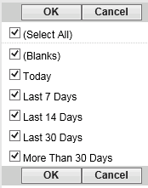
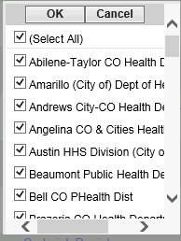
Tips for Monitoring Documents Needing Review Queue
Date Received shows oldest at top
View ones that are getting too old to meet completion within 30 days and take action
Click on Date Received to sort with newest on top and check for new reports that are urgent or use date filters
Best practice is to process off queue as soon as possible
Create investigation
Attach to existing investigation
Mark as reviewed
If you have statewide view you may want to filter by jurisdiction when not working on hepatitis or MDROs

Slide 17
Central Office Responsibilities
Maintain standards for case criteria and data entry
Epi Case Criteria Guide
NBS Data Entry Guide
Both are in txnedss.dshs.state.tx.us - /PHINDox/UserResources/
Review investigations in Approval Queue for Initial Notifications
See 05 Notification Approval Process.doc
Approve or reject with comment on what needs to be remediated
Monitor Documents Requiring Review queue for out of state lab reports
Forward information to other states
Quality assurance for all processes

Slide 18
Data Quality Assurance
Notification review Central Office
Case status criteria reflected in data entered
Condition concordant with lab reported test results
Basic demographic information completed
See 06 Notification Approval Process.doc
Monitoring queues for timeliness – LHD/RHD
Documents Requiring Review - within 2 weeks
Notification Rejection - within 10 days
Open investigation queue – review older investigations and complete
Ongoing Data Review – LHD/RHD
Line list of investigations
Filter for blank County, Birth Time, Sex, Race/Ethnicity
Filter for closed confirmed and probable cases without a notification (First Notification Date = blank)

Slide 19
Quality Assurance Goals
Annual Quality Assurance Goals - See 07 NBS Data QA Goals.doc
Annual Quality Assurance Goals
All of the MMWR Year’s records have been processed off of all of the queues on the NBS home page
All of the MMWR Year’s cases are entered and are identified as that year MMWR Year and Event Date
All of the MMWR Year’s records have a final Case Status (“C”, “P”, “N”, or, if defined as a final status, “S”) that meets the case definition for that classification
All records with Case Status of “C” or “P” have a notification that has been approved and sent to CDC (Texas reportable conditions only)
Each record has a date of birth (Birth Time) or age (Age Reported) that is reasonable for the condition
Each record has sex assigned (Current Sex Code = “F”, “M”, or “U” - preferably “F” or “M”)
As many records as possible have race (Concatenated Race Description) and ethnicity (Ethnic Group)
Records do not have both unknown race and selected races(s)
Each record has a County and it is consistent with address and jurisdiction
Records with died from illness = Yes also have deceased = Yes and a date of death entered on the patient tab of the investigation and patient with deceased = yes have yes, no, or unknown for did the patient die from this illness.
There are no duplicate cases in the data set of approved confirmed and probable cases
All investigations of approved confirmed and probable cases are closed (Investigation Status Code is “C”)
Earliest date suspected is not before onset date. Cases with onset date = earliest date suspected should also be reviewed to assure proper date was selected.
Other than date of birth, other dates in record should not be in a prior year except for conditions that cross years such as Chagas Disease, CJD, Hansen’s disease, and pediatric influenza mortality.
See NBS Login page - Documentation/UserResources/QA Data Report Modules

Slide 20
NBS Reports
See 11 List of NBS Reports.docx for description of reports
See txnedss.dshs.state.tx.us - /PHINDox/Data Dictionaries/
All reports start as template reports
Complex reports may be saved to reuse
Advanced filters
Field selection and order
Public or private copies
Public to share – delete after shared or no longer needed
See 17 Working with NBS Reports.docx and 18 Saving Reports.docx
Public reports may be altered (filters and/or fields)
Export data
Structure will not be altered
Changes can only be saved by original author
Data tables for the NBS Reports refresh each night. Changes made will not be available in the report data until the following day, even though they are available in the patient view as soon as the record is saved.

Slide 21
Useful NBS Template Reports
Event Metrics
Person who created each event with both name and NBS user ID
Line List of Individual Cases with Program Area and Jurisdiction Security
Limited to jurisdiction you have permission for
Has basic investigation information including system dates and actions and patient demographics
Can use Line List of Individual Cases - NO Program Area and Jurisdiction Security to see statewide data
See 13 Comparison NBS Investigation Line List With and Without Security 0212.xlsx
Line List of Resulted Lab Tests (Plus)
Most complete lab data
See 12 Comparison of Lab Report Templates in NBS 0412.xls
Has field (Investigation Local ID) that can be used to link to investigation data (Investigation ID2) for lab reports that are attached to an investigation
The data dictionaries for these 3 reports are in the notebooks

Slide 22
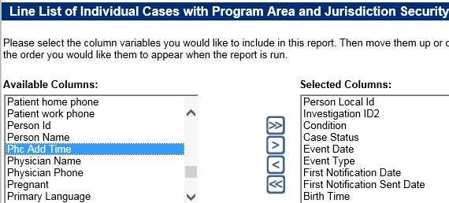
Useful NBS Report Fields – Investigation Line List
Person Local ID (PSN48#######TX01)
NOT “Person Id” – this is an RDB table ID – not useful to you.
Use unique numeric string between PSN48 and TX01 to look up patient record from Home page
In Excel, use find and replace (ctrl H) to find PSN48 and replace with nothing, then find TX01 and replace all to trim entire column down to searchable number.
PSN number associated with a record may change over time due to patient merges.
Investigation ID 2 (CAS48#######TX01)
NOT “Investigation ID” – this is an RDB table ID – not useful to you.
Will not change over time
Use whole string to look up record by Event ID Type – Investigation ID
Can be used to link to lab line list data
Condition and Case Status
Basic fields to assure you have included the correct records for your purpose
Exclude “Not a Case” in case count and QA data
Use the correct subset of Confirmed, Probable, and Suspect for your purpose
Include blank and Unknown Case Status for QA
Event Date and (Event Type)
Event date is a system generated triaged date
Event date defaults to one of the following dates , in the order displayed:
1. Onset Date (O)
2. Diagnosis Date (D)
3. Report to County Time (C)
4. Report to State Date (S)
5. Phc Add Time (date investigation was created) (P)
Onset date will be used if available. Data in lab reports is not utilized. Diseases which do not have a diagnosis date field substitute another investigation date in place of diagnosis date in the event date calculation , usually collection date of first positive culture.
First Notification Date
This is the date the first notification is created. It is a static date unless the notification is rejected. That action resets this field to blank until another notification is created.
Use this field in reports to assure all completed investigations that are reportable have notifications.
First Notification Sent Date
This is the date the first notification is approved and sent to CDC.
Most records should have a First Notification Sent Date within 30 days of first report to public health. Allow tome for notification review and corrections.
Birth Time (DOB)
There are 2 age dates in the line list but each have limitations. It is recommended for most purposes that age be calculated using the Birth Time and Event Date.
Age reported is based on age when investigation is created. It is close but may cross age categories.
Patient Age At Onset is a manually entered date and may be blank or inaccurate.

Slide 23
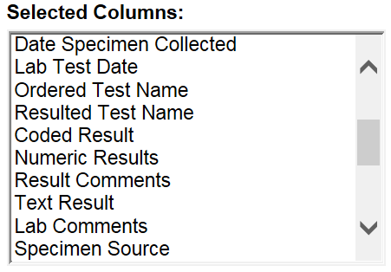
Useful NBS Report Fields – Line List of Resulted Lab Tests Plus
Person Local ID (PSN48#######TX01)
Use unique numeric string between PSN48 and TX01 to look up patient record from Home page
In Excel, use find and replace (ctrl H) to find PSN48 and replace with nothing, then find TX01 and replace all to trim entire column down to searchable number.
PSN number associated with a record may change over time due to patient merges.
Lab Local ID (OBS48#######TX01)
Will not change over time
Use whole string to look up record by Event ID Type – Lab ID
Investigation Local ID (CAS48#######TX01)
Can be used to link to investigation line list data
Date Created
Often Use as primary filter instead of Event Date range – will not change
Event date is triaged date - Event date defaults to one of the following items, in the following order 1) Specimen collection date, 2) Lab test date, 3) Date received by public health.
Program Area
Use for selection or stratification
Condition Name is >60% blank
Jurisdiction Code
Use Jurisdiction Code in filter rather than Jurisdiction Name. There is a known unfixed bug that may result in incomplete data using Jurisdiction Name.
May use Jurisdiction Name as column selected in report
ELR Indicator
Y – ELR lab report
N – Manually entered lab report
blank – Lab report simulated from a morbidity report
Case Review Status
LOG_DEL – Deleted record
PROCESSED – Action taken - off Documents Requiring Review queue
UNPROCESSED –On Documents Requiring Review queue
blank – Lab report simulated from a morbidity report
Last Changed User Name
Filter for Last Changed User Name = Elrload, NEDSS and Case Review Status = PROCESSED to find lab reports that were auto marked as reviewed.
Ordered and Resulted Test Names and Result Fields
Ordered Test Code and Resulted Test Code
Useful to build filters to select specific test results

Slide 24
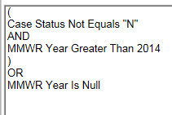
Report Logic
Logic Separators
Use AND between fields if both must be true
Use OR between fields when only one must be true
Use () around multiple statements for one field and to separate OR and AND statements
Use arrows to move statements
Up Down Out - One row or All
If report returns no data, check your logic
Filters – Must use at least one filter
Do not have to use basic filter if you use an advanced filter
Logic choices depend on field type
Categories
Numeric
Categorical data
Equals or Not Equals
Choosing from drop down list – can use Ctrl key to select more than one
Free text – must be exact- case sensitive
Is Null or Is Not Null
Numeric data
Equals or Not Equals
Type one date or number
Between
Type date range - inclusive
Less Than or Greater Than
Type one date or number – not inclusive
Insert logic as selected
Example 2
Example 1
SQL View

Slide 25
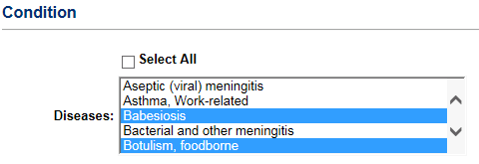
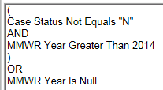
NBS Public Reports
Public and private report template filters and report fields can be altered as needed.
Advantages – Utilize existing complex filters Utilize existing field selection and organization
QA Data Example – current structure
Basic filter – reportable conditions selected
Update each year as reportable conditions are added and deleted
Advanced filter – exclude Not a Case and selects based on MMWR Year criteria
Fields selected and grouped – IDs, condition and status, dates, location, demographics
Edit for other usage as needed
Include only confirmed, probable cases, and suspect cases
Edit MMWR Year
Add, remove, or rearrange selected columns
Export date
You can’t save changes to a public report unless you are the author.

Slide 26
Case Count Data
NBS has cases that have been ruled out, are in the process of being investigated and approved, and completed cases.
For case counts select the appropriate filters
Case Status – Confirmed or Probable
Use First Notification Sent Date not null for cases that have been finalized and approved
Time frame – by MMWR Year
Use report filters or filter in Excel
Provisional data levels
Include cases without final status that have not been ruled out
Include cases with final status with notification created (First Notification Date not null)
Include cases with final status with notification created (First Notification Sent Date not null)

Slide 27
Preparing NEDSS Report Data in Excel
Open CSV file and save as Excel
Format data
Expand fields
Click in upper left-hand corner to select all data and double click a column divider
Format dates
Select first column with date, right click, format cells, select top date format
Select other date columns and use F4 (repeat last action key) to format others
Resize columns that are too wide for screen
Select column, right click, resize column from 255 to 25. Use F4 (repeat) for additional columns
Trim Person Local ID to unique digits
Use Find and Replace (Ctrl H)
Find “PSN48” and replace with nothing
Find “TX01” and replace with nothing
This will allow easy copying to look up patient in NBS
Save as Excel file
View data
Filter
Pivot tables

Slide 28
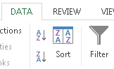
Filtering NEDSS Report Data in Excel
Filter data
Select all data by clicking in upper left hand corner
In the menu bar, click on Data and Filter
Filter to select data of interest
Blank County
Quick QA using filters
Filter for each of the following one at a time and highlight the rows
County blank
Birth Time blank
Case Status blank or “U”
First Notification Date blank
Filter for the highlighted color
Remediate the records

Slide 29
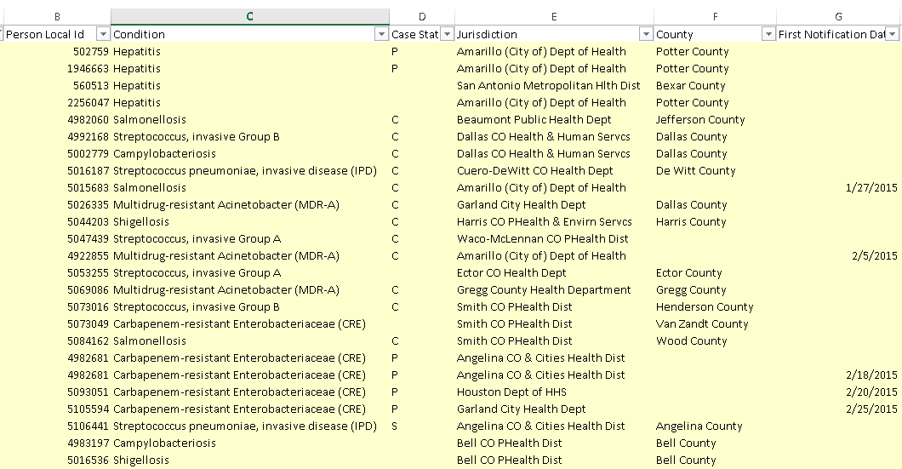
Filtering Results

Slide 30
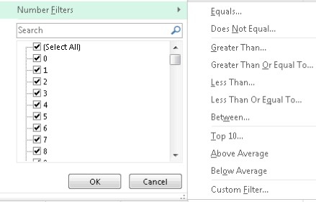
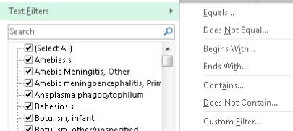
Filtering NEDSS Report Data in Excel
Filtering options – text
Selection
Search
Text content
Filtering options – numeric
Selection
Numeric range

Slide 31
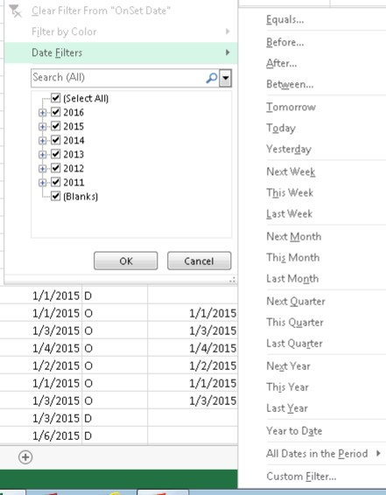
Filtering NEDSS Report Data in Excel
Filtering options – date
Selection
Search
Date ranges

Slide 32
Data Enhancement - Age
Calculate age using Event Date and Birth
Calculate Age in years using DATEDIF formula
Sort by Birth Time (DOB)
If DOB = 1/1/1901 assume it is a fictitious date and delete it (year increases by 1 each year) then resort
Filter for Birth Time not blank
Create a new column, Calc Age Yrs
Format the cells in the column as numbers with no decimals
Use the DATEDIF function to calculate the age in years at event date
Copy the formula down the Calc Age Yrs column through the rows that have a Birth Date value
Filter for Birth Time is blank
Fill in with age from other age field if available
Type Unknown if no age data is available
=DATEDIF(cell,cell,”y”)
In DATEDIF formula earlier date goes first
=DATEDIF(Birth Time cell,Event Date cell,”y”) for age in years
Use “y” for age in years, “m” for age in months, and “d” for age in days
Event date = Onset date if known and will not be blank
Most accurate age
Age Reported is the patient’s age when the investigation is entered in NEDSS
Patient Age At Onset is a manually entered field and is very incomplete and subject to error

Slide 33
NEDSS Report Excel Data Enhancement – Age Group
Copy Calc Age Yrs column and Paste Special as values in same column
Sort by Calc Age Yrs
Create a new column, Age Group
Use VLOOKUP to fill in age group
Format the cells in the column as text
Use Excel file with ages and desired age groups as look up table
Use the VLOOKUP function to fill in the age group based on Calc Age Yrs
Copy the formula down the Age Group column
Filter Age Group and assure there are no blanks
Parts of the VLOOKUP formula

Slide 34
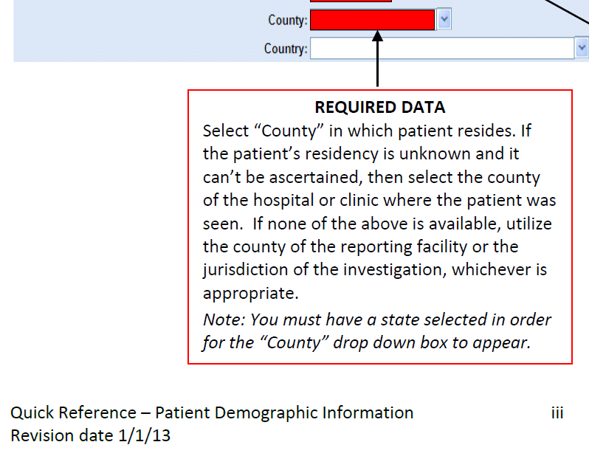
Data Enhancement - HSR
Sort by Jurisdiction
Filter for Out of State then enter Out of State for HSR and HSR Group
Sort by County and select County not blank and Jurisdiction not out of state
Use VLOOKUP table to assign HSR and HSR group by county
Select County is blank
Use VLOOKUP table to assign HSR and HSR group by jurisdiction
Remediate missing counties in NEDSS on patient tab of investigation
Patient county
If patient address unknown use county of ordering provider or ordering facility
If provider unknown use county of reporting facility or investigating jurisdiction as appropriate
Do not assign city or zip if patient address is unknown
See DEG quick reference guide for investigations

Slide 35
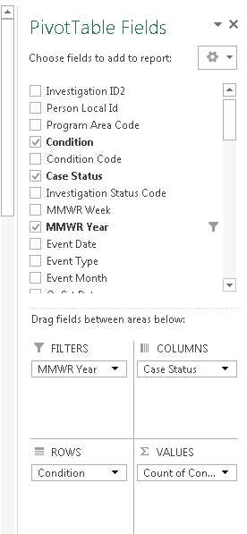
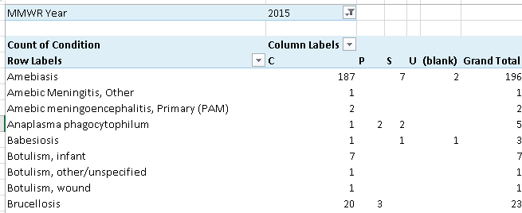
Excel Pivot Table
Use a field for values that does not have blanks – usually a required or system generated field
Use page filters or row and column filters as needed
Rename labels

Slide 36
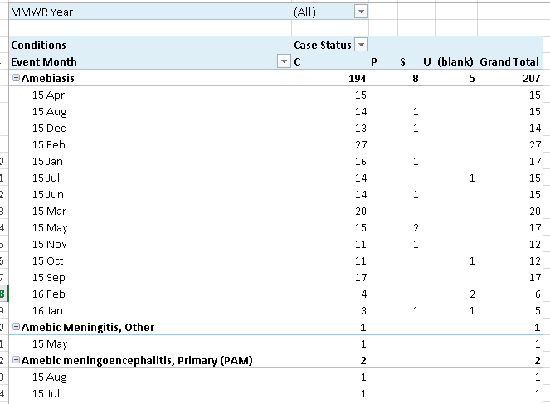
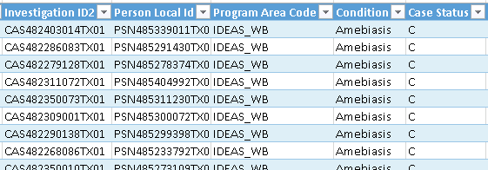
Excel Pivot Table – Stacked Rows
Stack rows
Generate line list for any subset by right clicking on cell

Slide 37
Excel Pivot Table - Percentage
Percentage or row, column, or total
Value – condition x 2
Select cell in 2nd column for pertussis, rt click, show values as, % of column total
Rename columns Count and Percent; format % to 1 decimal
 | Pertussis |  | Varicella (Chickenpox)
Age Group | Count | Percent | Count | Percent
<1 Yr | 285 | 19.9% | 185 | 12.7%
01-04 Yr | 278 | 19.4% | 342 | 23.4%
05-09 Yr | 208 | 14.5% | 415 | 28.4%
10-14 Yr | 203 | 14.2% | 193 | 13.2%
15-19 Yr | 97 | 6.8% | 80 | 5.5%
20-24 Yr | 19 | 1.3% | 51 | 3.5%
25-29 Yr | 35 | 2.4% | 35 | 2.4%
30-34 Yr | 42 | 2.9% | 34 | 2.3%
35-39 Yr | 48 | 3.4% | 42 | 2.9%
40-44 Yr | 37 | 2.6% | 33 | 2.3%
45-49 Yr | 39 | 2.7% | 18 | 1.2%
50-54 Yr | 35 | 2.4% | 5 | 0.3%
55-59 Yr | 25 | 1.7% | 10 | 0.7%
60-64 Yr | 21 | 1.5% | 3 | 0.2%
65+ Yr | 58 | 4.1% | 14 | 1.0%
Grand Total | 1430 | 100.0% | 1460 | 100.0%

Slide 38
Excel Pivot Table - Charts
Graph food and water borne conditions by event month
Use program area filter
Use jurisdiction filter to look at each jurisdiction
Pivot table: Filters – Program Area and Jurisdiction, Row- Event Month, Column and Value – Condition
Show creating line graph from pivot table; switch row and column (rt click, select data, switch)
Hide all field buttons on chart
Add title and axis titles (Design, Add Chart Element)

Slide 39
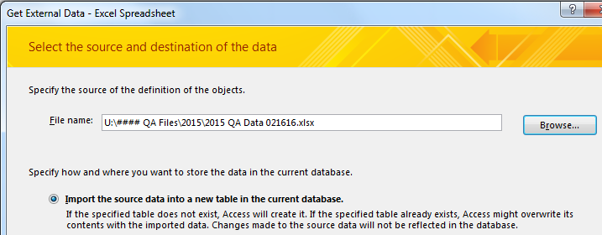
Using NEDSS Report Data in Access
Import into Access
Open/Create Access database
External Data tab
Excel
Browse
Select file
OK
Prepare data for import
Run report data -> CSV file exported
Expand fields
Click in upper left-hand corner to select all data and double click a column divider
Format dates
Select first column with date, right click, format cells, select top data format
Select other date columns and use F4 (repeat last action key) to format
Delete extension on Zip Code
Use Find and Replace (Crtrl H), find “-****” and replace with nothing
Save as Excel file

Slide 40
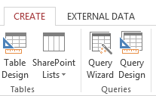
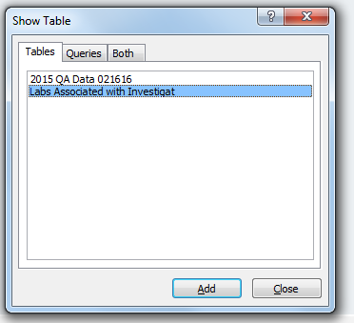
Access Query – Join Lab and Investigation Data
Create in Query Design
Add tables by double clicking on each
Click on Investigation ID2 in investigation data and drag to Investigation Local ID in lab data
Then click on line to get join properties

Slide 41
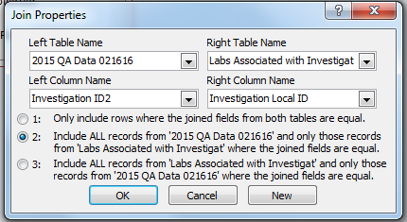
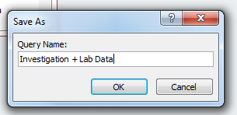
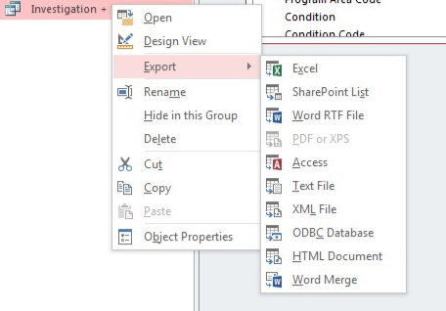
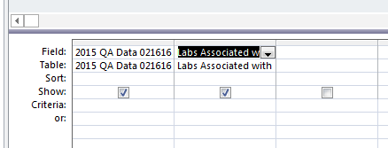
Access Query – Join Lab and Investigation Data – continued
Select all investigation and matching lab records OK
Select fields by pulling down to Field row. Use * to select all fields
Select datasheet view to check
Save file
Right click on query and select Export and Excel

Slide 42
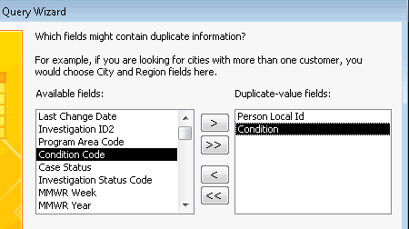
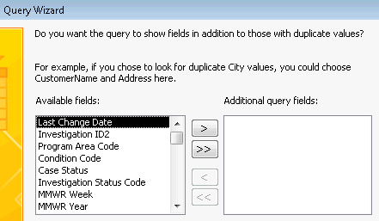
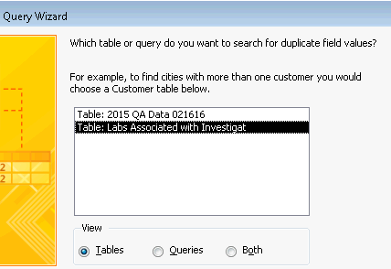
Access Query – Find Duplicate Query
Select fields to match on (e.g., Person Local ID and Condition)
Select fields to include. Use >> to select all.
Compare duplicates
Consider whether different species of organism or separated by enough time to be separate cases
If duplicates – close 1 as Not a Case and conserve best information in surviving record (earliest date reported, completeness of data, etc.)
Create in Query Wizard
Select Find Query Wizard
Select table with data to be checked

Slide 43
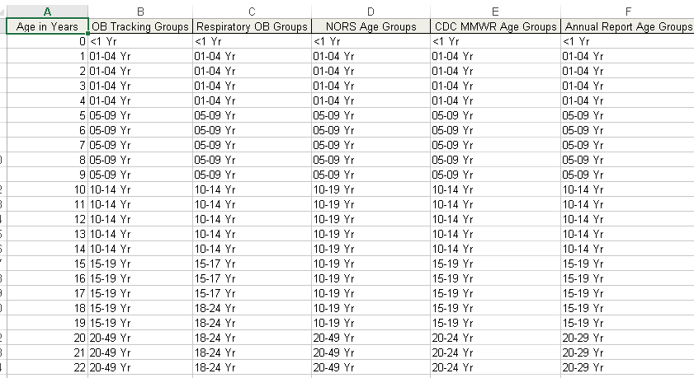
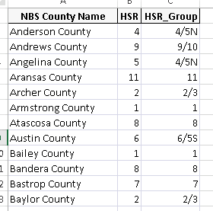
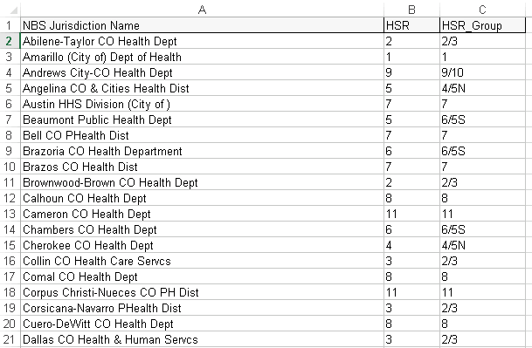
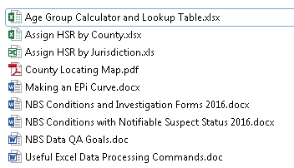
Email Packet – Electronic resources
Email request to laura.tabony@dshs.state.tx.us

